Slide 1
Matrix Algebra
Fun with Numbers

Slide 2
Matrices
Many things we’ve already talked about/do on a normal day include matrices.
How might you represent the grades in this class?
 | Grade 1 | Grade 2 | Grade 3
Student 1 | A | B | C
Student 2 | D | E | F

Slide 3
Matrices
Important terms
Rows
Columns
Talk about matrices as (R X C)
So a 2X3 would have 2 rows and 3 columns (like our example).

Slide 4
Matrices
Square matrices have an equal number of rows and columns
Called “to the order of n” or a NXN matrix.

Slide 5
Addition
First: the two matrices MUST be the same size
Same RXC combination
You add the numbers with the same row and column designation (see handout)
 | Grade 1 | Grade 2 | Grade 3
Student 1 | A | B | C
Student 2 | D | E | F
 | Grade 1 | Grade 2 | Grade 3
Student 1 | Q | R | S
Student 2 | T | U | V

Slide 6
Subtraction
Remember that math rule that:
M – N = M + -N?
You apply that to the addition rule from above.
Just make sure you line up the rows and columns.

Slide 7
HEY!
Don’t forget the order of operations
A – B – C does not equal A – (B-C).
Be sure to do them left to right.

Slide 8
Multiplication – One
Let’s say I’ve realized that I’ve done everyone’s grades wrong and need to multiply by 2
2 (matrix) = 2*A, 2*B, etc.
 | Grade 1 | Grade 2 | Grade 3
Student 1 | 2A | 2B | 2C
Student 2 | 2D | 2E | 2F

Slide 9
Multiplication Matrices
Multiplying two actual matrices is a bit trickier.
Rules:
R1XC1 matrix and R2XC2 matrix
C1 = R2
Or basically the interior numbers need to match.
End result: R1XC2 matrix

Slide 10
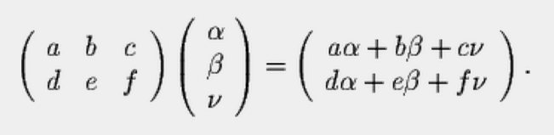
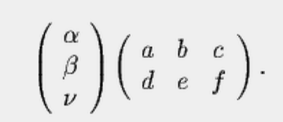
Example

Slide 11
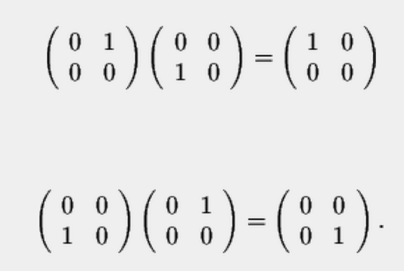
Order Matters
In regular math A X B = C and B X A = C
Not in matrix algebra.

Slide 12
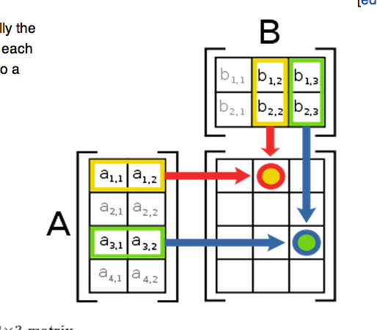
Example

Slide 13
Identity Matrix
This matrix is the set of zeros with 1s running down the diagonal
1 | 0 | 0
0 | 1 | 0
0 | 0 | 1

Slide 14
Identity Matrix
The identity matrix (I) times a matrix is the matrix.
I*A = A

Slide 15
Identity Matrix
Why learn about a matrix that is basically like multiplying by 1?
They help you determine if a matrix is NONSINGULAR
Regression! Factor analysis! Etc.!

Slide 16
Invertible Matrices
IF A*B = I
Then the A matrix is nonsingular or invertible.
The B matrix is its inverse.
Notation: A⁻¹

Slide 17
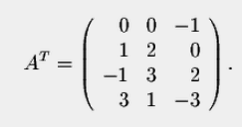
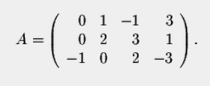
Invertible Matrices
How can I tell if a matrix is invertible?
Transposes
A^{T}
Exchange rows and columns (turn it on it’s side)

Slide 18
Invertible Matrices
Determinants
Matrix is invertible if ad – bc /= 0
Ie the diagonal multiplication is not zero.
The determinant is ad – bc.
A | B
C | D

Slide 19
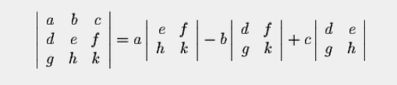
Invertible Matrices

Slide 20

Invertible Matrices
The point of all this is division – you can’t divide matrices, but you can multiply by the inverse.

Slide 21
The Point!
Regression is matrix algebra.
Knowing these ideas help you conceptual how “least squares” is calculated.
Also helps you understand what the “hessian matrix not definite, singular matrix” errors in SPSS.

Slide 22
Regression Matrix Style
Ok we know simple regression is: y = a + bx
(or mx + b) if you like.

Slide 23
Regression Matrix Style
How do you get a and b?
B matrix = (X^{T}X)-¹ * X^{T}Y

Slide 24

Regression Matrix Style
B matrix = (X^{T}X)⁻¹ * X^{T}Y

Slide 25
Regression Matrix Style
B matrix = (X^{T}X)⁻¹ * X^{T}Y
Take the inverse of the previous slide

Slide 26
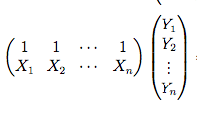
Regression Matrix Style
B matrix = (X^{T}X)-¹ * X^{T}Y

Slide 27
Regression Matrix Style
Viola! You have a and b.
You can make this multiple regression by adding more X columns (although I wouldn’t recommend this math by hand ☹).

